Slide 1
VX Awards
Evaluator Onboarding
Onboarding Session
August 2026

Slide 2
Purpose of Today’s Discussion
This session introduces the Visitor Experience Awards, outlining the evaluation process, evaluator responsibilities, and the use of the evaluation portal to ensure fair and consistent assessments
1
2
3
Introduction to the Visitor Experience Awards
Understand the vision, objectives, and overall structure of the VX Awards, and how they contribute to elevating visitor experience across Abu Dhabi
Understanding Your Role as an Evaluator
Learn the evaluation process, scoring methodology, key responsibilities, and principles for conducting fair and consistent assessments
Navigating the Evaluation Portal
Become familiar with the evaluation portal, including logging in, declaring conflicts of interest, reviewing applications, and submitting evaluations

Slide 3
Purpose of Today’s Discussion | 1. Introduction to the Visitor Experience Awards
This session introduces the Visitor Experience Awards, outlining the evaluation process, evaluator responsibilities, and the use of the evaluation portal to ensure fair and consistent assessments
1
2
3
Introduction to the Visitor Experience Awards
Understand the vision, objectives, and overall structure of the VX Awards, and how they contribute to elevating visitor experience across Abu Dhabi
Understanding Your Role as an Evaluator
Learn the evaluation process, scoring methodology, key responsibilities, and principles for conducting fair and consistent assessments
Navigating the Evaluation Portal
Become familiar with the evaluation portal, including logging in, declaring conflicts of interest, reviewing applications, and submitting evaluations

Slide 4

Introduction to the Visitor Experience Awards
The Visitor Experience Awards is DCT's flagship initiative celebrating organisations and frontline professionals that deliver exceptional visitor experiences across Abu Dhabi
Visitor Experience Awards
~450
BUSINESSES INVITED to apply for the VX Awards
~350
DISTINGUISHED INVITEES to attend the ceremony with VIP presence
24
WINNERS SELECTED across 8 award categories
An annual flagship program run by DCT VX designed to recognize and motivate excellence and drive healthy competition among tourism businesses and frontline staff across Abu Dhabi
Events Ceremony Planned for
Nov. 26 at ERTH Abu Dhabi Hotel
PRESTIGIOUS ceremony with GALA DINNER
PUBLIC RECOGNITION of selected winners
A night of PRIDE, INSPIRATION, AND NETWORKING

Slide 5
Introduction to the Visitor Experience Awards | Award Categories
The Visitor Experience Awards recognize excellence across multiple dimensions of visitor experience, celebrating both organisations and frontline professionals who contribute to Abu Dhabi's tourism success
8 Award Categories
Business Awards
Frontliner Awards
1
Most Innovative Experience Award
Recognizes businesses that introduce innovative solutions or concepts that significantly enhance the visitor journey
1
Visitor Experience Superstar Award
Honors exceptional frontline tourism professionals who are the visible face of Abu Dhabi’s visitor experience
2
Best Emirati Cultural Experience Award
Recognizes businesses that promote and embed Abu Dhabi’s culture and heritage to elevate visitor experience
2
Unsung Hero Award
Recognizes frontline staff whose roles are essential to every visitor journey but often less in the spotlight
3
Leader in Inclusive Experience Award
Recognizes businesses that ensure accessibility and inclusivity, showcasing Abu Dhabi’s leadership in inclusive tourism
3
Connectivity Champion Award
Honors transport and mobility frontliners who ensure smooth, safe, and guest-oriented journeys across the Emirate
4
Most Resilient Business Award
Recognizes businesses that demonstrate exceptional resilience in overcoming unforeseen challenges
4
Outstanding Tour Guide Award
Recognizes licensed guides acting as ambassadors through knowledge, storytelling and authentic representation

Slide 6
Purpose of Today’s Discussion | 2. Understanding Your Role as an Evaluator
This session introduces the Visitor Experience Awards, outlining the evaluation process, evaluator responsibilities, and the use of the evaluation portal to ensure fair and consistent assessments
1
2
3
Introduction to the Visitor Experience Awards
Understand the vision, objectives, and overall structure of the VX Awards, and how they contribute to elevating visitor experience across Abu Dhabi
Understanding Your Role as an Evaluator
Learn the evaluation process, scoring methodology, key responsibilities, and principles for conducting fair and consistent assessments
Navigating the Evaluation Portal
Become familiar with the evaluation portal, including logging in, declaring conflicts of interest, reviewing applications, and submitting evaluations

Slide 7
Understanding Your Role as an Evaluator | Winner Selection Process
The Visitor Experience Awards recognize excellence across multiple dimensions of visitor experience, celebrating both organizations and frontline professionals who contribute to Abu Dhabi's tourism success
Where you play a critical role
1
2
3
Evaluation Rounds
Jury Rounds
Award Winners
Input
Input
Input
~100+ applications submitted by invited businesses and frontliners via the portal
72 applications shortlisted from evaluation rounds
24 awardees finalized from jury rounds
Applications are checked for completeness; incomplete entries are rejected¹
A panel of three sector experts per category⁴ independently reviews finalist submissions and prior mystery shopper/ Sprinklr reports (for businesses)
VX team uses the scores submitted by the jury to rank top 3 awardees per award category and consults the jury in case of no clear winner. The 3 winners selected per category are then publicly awarded during the VX Awards ceremony.
1
1
1
Eligible applications are scored independently by two anonymous evaluators²
2
The jury submits the final scores based on their independent evaluation to the VX team
2
Scores submitted by the two evaluators are averaged to produce one final application score
Gold winner
3
The jury may be consulted to agree on Gold, Silver, and Bronze winners per category, if needed
Silver winner
The top nine applications per award category progress to the jury round³
3
4
Bronze winner

Slide 8
Understanding Your Role as an Evaluator | Business Application Format
Based on benchmark insights, the VX Award application should follow a clear set of sections that apply across all award categories, making the form modular and flexible for future cycles, with tailoring achieved through the content focus and emphasis of each category
Non-Scored Section
Business Awards - Scored Section
Useful Information Before you Start
Show how you excel in this category
A
Provides applicants with clear steps, timelines, and requirements (e.g. in English) to ensure complete and compliant submissions
1
Explain the initiatives, strategies, practices or solutions introduced or improved during the award year that demonstrate excellence in this category
Eligibility Criteria
B
Outlines who can apply and what makes an entry valid, ensuring fairness and transparency
Show how your excellence enhances visitor experience
2
Provide evidence of how improvements made this year have positively impacted visitor journeys, satisfaction or engagement
Applicant & Business Details
C
Collects essential details about the business and point of contact filling the form, this helps establish context for evaluation
3
Show how your approach can endure and inspire others
Describe how the progress is sustained and being embedded, demonstrating long-term commitment rather than one-off initiatives
Why You Should Win
D
Gives applicants space to summarize their overall case and highlight what makes them stand out
4
Show what enables your success
Promotional Materials & Final Declarations
Highlight the enablers (people, training, technology, data, partnerships) that supported the nominees improvements during the award year
E
Requests images from the applicants to be used in promotional releases and final declaration of the accuracy of submitted information
While the form structure stays constant, tailoring happens in the category introduction and the guidance under each question,
where examples are adapted to reflect the specific focus of the award category

Slide 9
Understanding Your Role as an Evaluator | Frontliner Application Format
Based on benchmark insights, the VX Award application should follow a clear set of sections that apply across all award categories, making the form modular and flexible for future cycles, with tailoring achieved through the content focus and emphasis of each category
Non-Scored Section
Frontline Staff Awards - Scored Section
Useful Information Before You Start
Describe what makes the nominee exceptional in their role
A
Provides applicants with clear steps, timelines, and requirements (e.g. in English) to ensure complete and compliant submissions
1
Demonstrate deep knowledge, adaptive storytelling, handling of sensitive topics, and standout tour moments
Eligibility Criteria
B
Outlines who can apply and what makes an entry valid, ensuring fairness and transparency
Show the mark they leave on the visitors they meet
2
Show lasting impressions via guest feedback, group management, and satisfaction metrics with sources and dates
Applicant & Nominee Information
C
Collects essential details about the business/nominee and point of contact filling the form, this helps establish context for evaluation
3
Show that this is a sustained standard, not a one-off
Prove consistent high performance across 12 months with recognition and evidence spread throughout the year
Why You Should Win
D
Gives applicants space to summarize their overall case and highlight what makes them stand out
Promotional Materials & Final Declarations
E
Requests images from the applicants to be used in promotional releases and final declaration of the accuracy of submitted information
While the form structure stays constant, tailoring happens in the category introduction and the guidance under each question,
where examples are adapted to reflect the specific focus of the award category

Slide 10
Understanding Your Role as an Evaluator | Scoring Method
Each scoring form uses a consistent 1–5 scale with question-specific definitions, giving evaluators and jurors a clear framework for what constitutes each performance level and ensuring consistent assessment across categories
Business Awards - Scoring Form
Scoring Scale
Question-specific definitions provided to evaluators and jurors
1
2
3
4
5
Q1
POOR
Weak or no evidence; practices appear reactive, one-off, or ad-hoc; at or below compliance
standards
BASIC
Some evidence provided; shows early progress beyond minimum compliance but lacks consistency
GOOD
Demonstrates structured, ongoing practices with credible supporting evidence, clear improvements achieved during the year
ADVANCED
Strong, well-documented practices delivering significant improvements; evidence shows proactive planning, monitoring, and innovation
EXEMPLARY
Sector-leading practices with comprehensive, high-quality evidence; demonstrates transformative results; impact is exceptional and sets a benchmark for others
Q2
Q3
Q4
Frontliner Awards - Scoring Form
Scoring Scale
Question-specific definitions provided to evaluators and jurors
1
2
3
4
5
Q1
POOR
No specific examples or evidence; only claims or isolated incidents with no demonstrated impact or consistency
BASIC
Competent performance with routine examples; may include indirect evidence but does not demonstrate a sustained standard
GOOD
Actively goes beyond routine with clear instances of impact; demonstrates warmth, proactive care, or initiative supported by evidence
ADVANCED
Multiple examples from varied sources; evidence of consistent performance throughout most of the 12-month period, including under pressure
EXEMPLARY
Exceptional sustained pattern across full year displaying an above‑norm performance that redefines the role and sets new standards
Q2
Q3

Slide 11
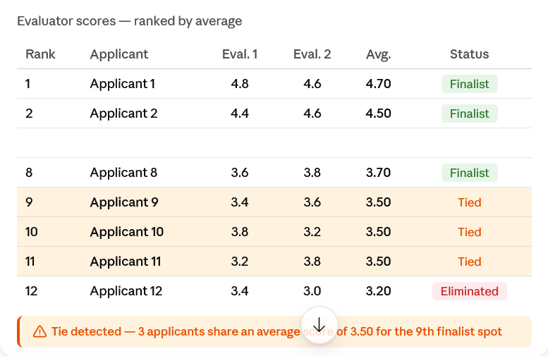
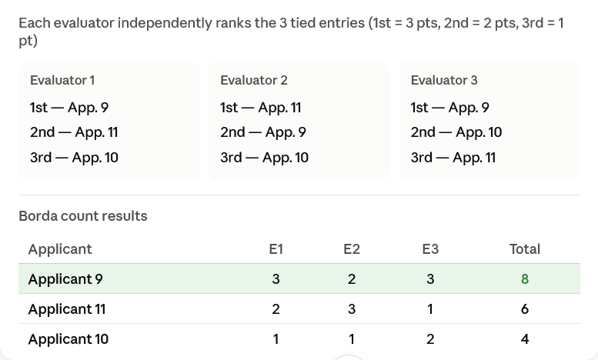
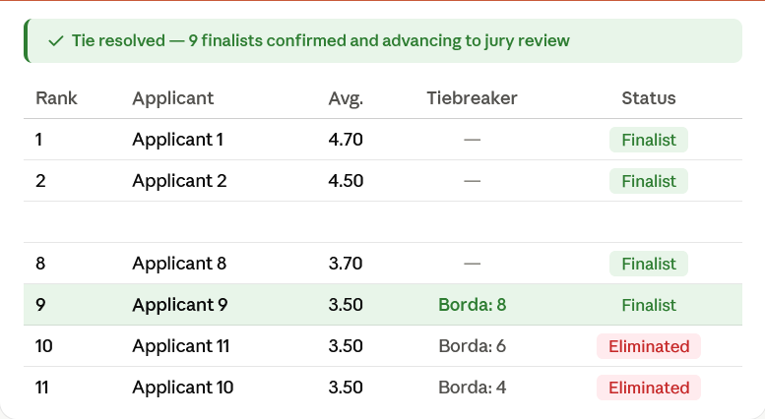
Understanding Your Role as an Evaluator | Tie breaker
A structured resolution process is applied when tied scores prevent clear selection of finalists or winners
When tied scores prevent clear selection, evaluators follow the process below:
Tie is identified
by the VX team
Tie is resolved
via Borda count
Finalists/Winners
are selected
1
2
3
Example
Evaluator
A tie among applicants prevents identification of the top 9 finalists
A third evaluator is assigned; all three independently rank the tied entries against each other
A Borda count score is calculated from the three rankings and the top 9 finalists are confirmed

Slide 12
Understanding Your Role as an Evaluator | Journey
The evaluation process is designed to ensure a fair, consistent, and transparent selection of the Visitor Experience Awards finalists and winners
Receive Applications
Completion Check
Evaluation Rounds
Tie Breaking Rounds
Awards Ceremony
Aug. 6 – Sep. 2
4 weeks
Aug. 27 – Sep. 23
4 weeks
Aug. 27 – Sep. 23
4 weeks
Sep. 28 – Oct. 2
1 week
Nov. 26
Q4 2026
Businesses and frontline professionals submit their applications through the portal, providing responses and supporting evidence for evaluation
Review each assigned application to confirm that all required sections have been completed correctly. If an application is incomplete, return it to the VX Awards team
Assess each eligible application against the defined evaluation criteria, assigning objective scores and evidence-based comments for each criterion
Where applications receive identical scores, selected evaluators may be invited to complete an additional review to support the final shortlist submitted to the jury.
Following the jury's final decision, attend the Visitor Experience Awards ceremony to celebrate and recognize this year's winners.

Slide 13
Understanding Your Role as an Evaluator | Principles
Maintaining the integrity of the VX Awards requires every evaluator to uphold the highest standards of fairness, impartiality, and confidentiality throughout the evaluation process
1
2
3
Be Objective and Consistent
Declare Conflicts of Interest
Maintain Confidentiality
Assess every application fairly using only the evidence provided and apply the scoring criteria consistently across all submissions
Declare any actual, potential, or perceived conflicts of interest before commencing your evaluations to ensure a fair and impartial assessment process
Treat all application materials, evaluation outcomes, and discussions as strictly confidential and do not disclose any information outside the evaluation process
You or an immediate family member have previously worked for or with a nominated entity
You or an immediate family member are currently discussing employment or business opportunities with a nominated entity
You or an immediate family member hold an ownership stake or direct financial interest in a nominated entity

Slide 14
Purpose of Today’s Discussion | 3. Navigating the Evaluation Portal
This session introduces the Visitor Experience Awards, outlining the evaluation process, evaluator responsibilities, and the use of the evaluation portal to ensure fair and consistent assessments
1
2
3
Introduction to the Visitor Experience Awards
Understand the vision, objectives, and overall structure of the VX Awards, and how they contribute to elevating visitor experience across Abu Dhabi
Understanding Your Role as an Evaluator
Learn the evaluation process, scoring methodology, key responsibilities, and principles for conducting fair and consistent assessments
Navigating the Evaluation Portal
Become familiar with the evaluation portal, including logging in, declaring conflicts of interest, reviewing applications, and submitting evaluations

Slide 15
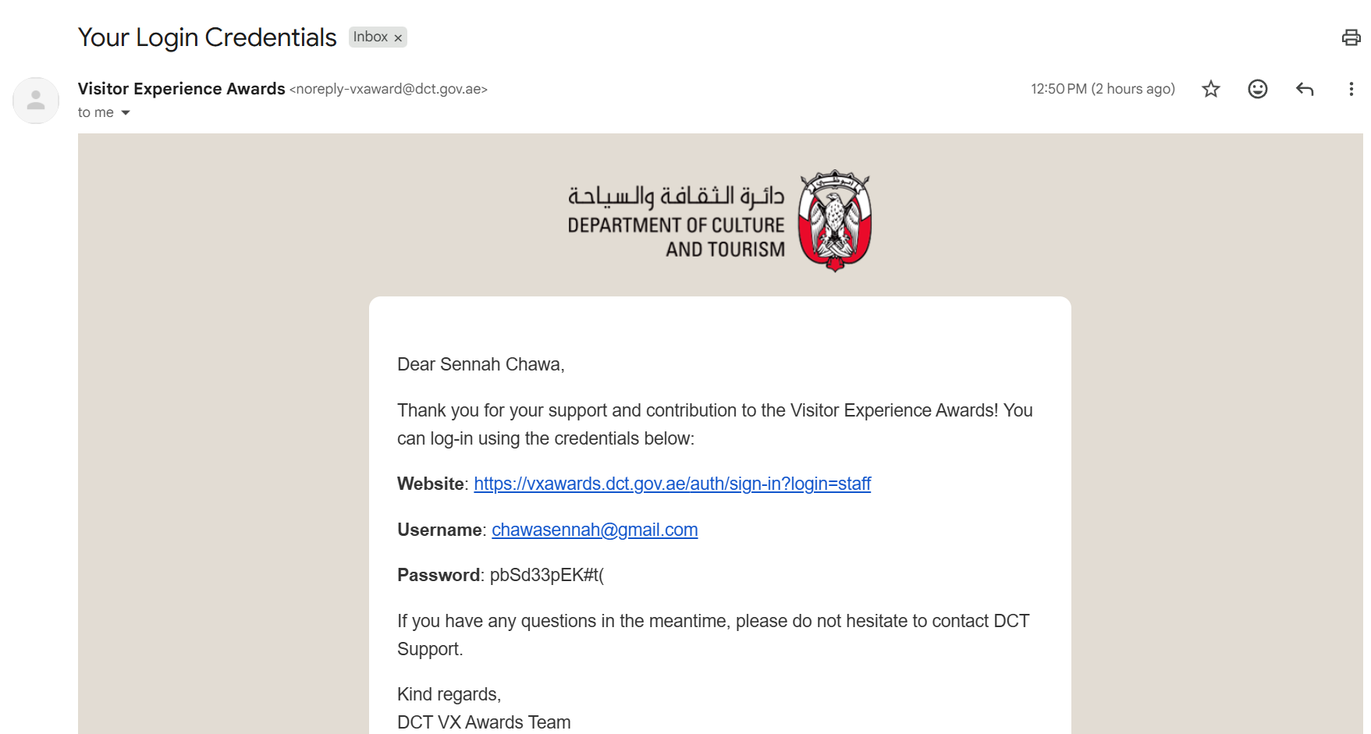
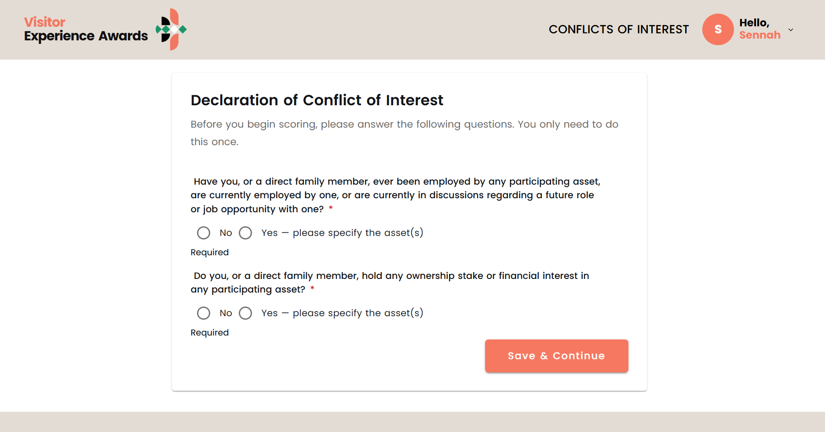
Navigating the Evaluation Portal
Registering and declaring your conflicts of interest (1/2)
Step 1:
You will receive on your email your login credentials. Please paste the link to your browser and input your username and password.
Step 2:
Upon signing in, you will be prompted to declare any conflicts of interest.

Slide 16
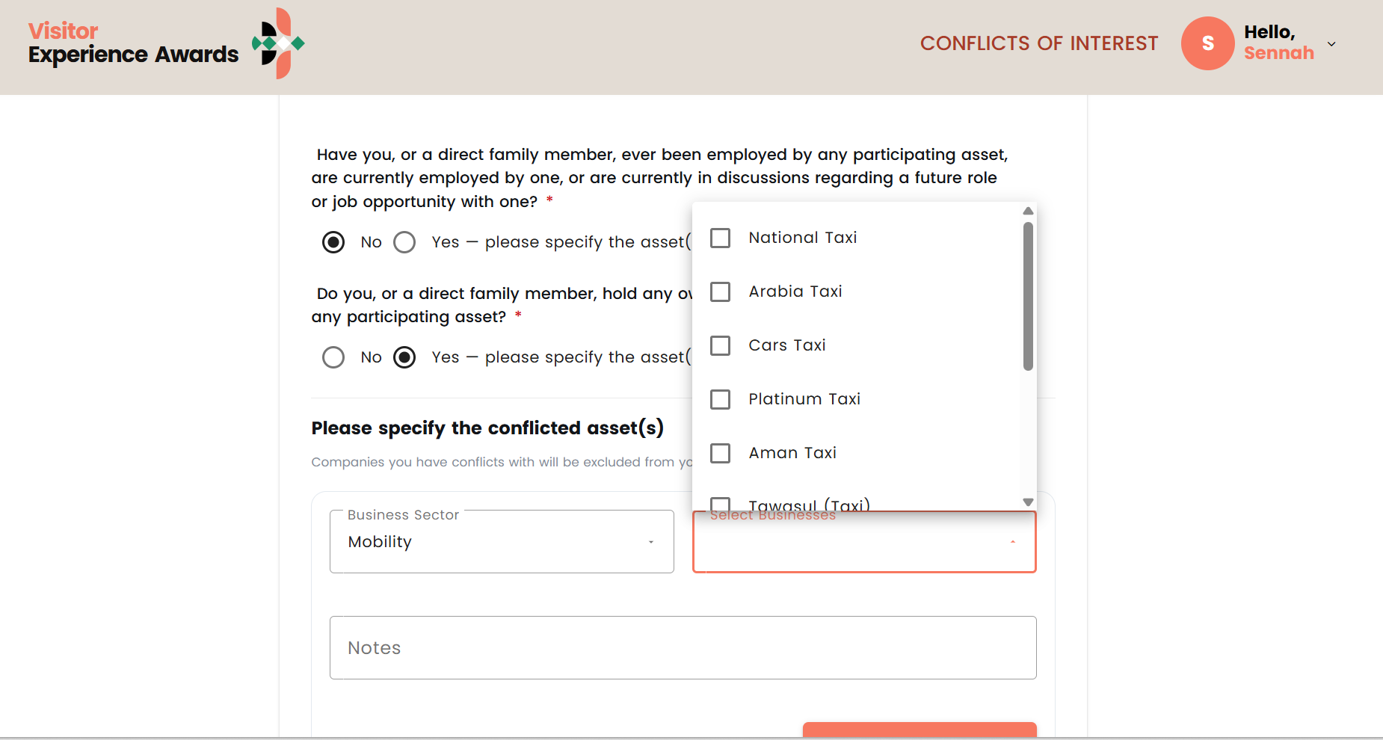
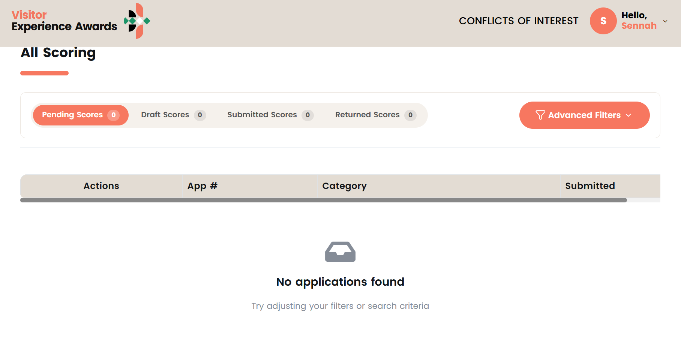
Navigating the Evaluation Portal
Registering and declaring your conflicts of interest (2/2)
Step 3:
To view which businesses are nominees, please select “yes” and explore the list of businesses in the drop-down menu.
Step 4:
Upon declaring your conflicts of interest, you will be able to see which applications are pending scoring.

Slide 17
Thank You

